Slide 1
Regression, Overfitting and Optimization
Course material at: https://git.io/fjFga
Monday, Lecture 2
FASE ML Bootcamp
Based on material from Joseph Redmon, Christopher Bishop, Polo Chau
Elements of Statistical Learning by Hastie, Tibshirani, Friedman

Slide 2
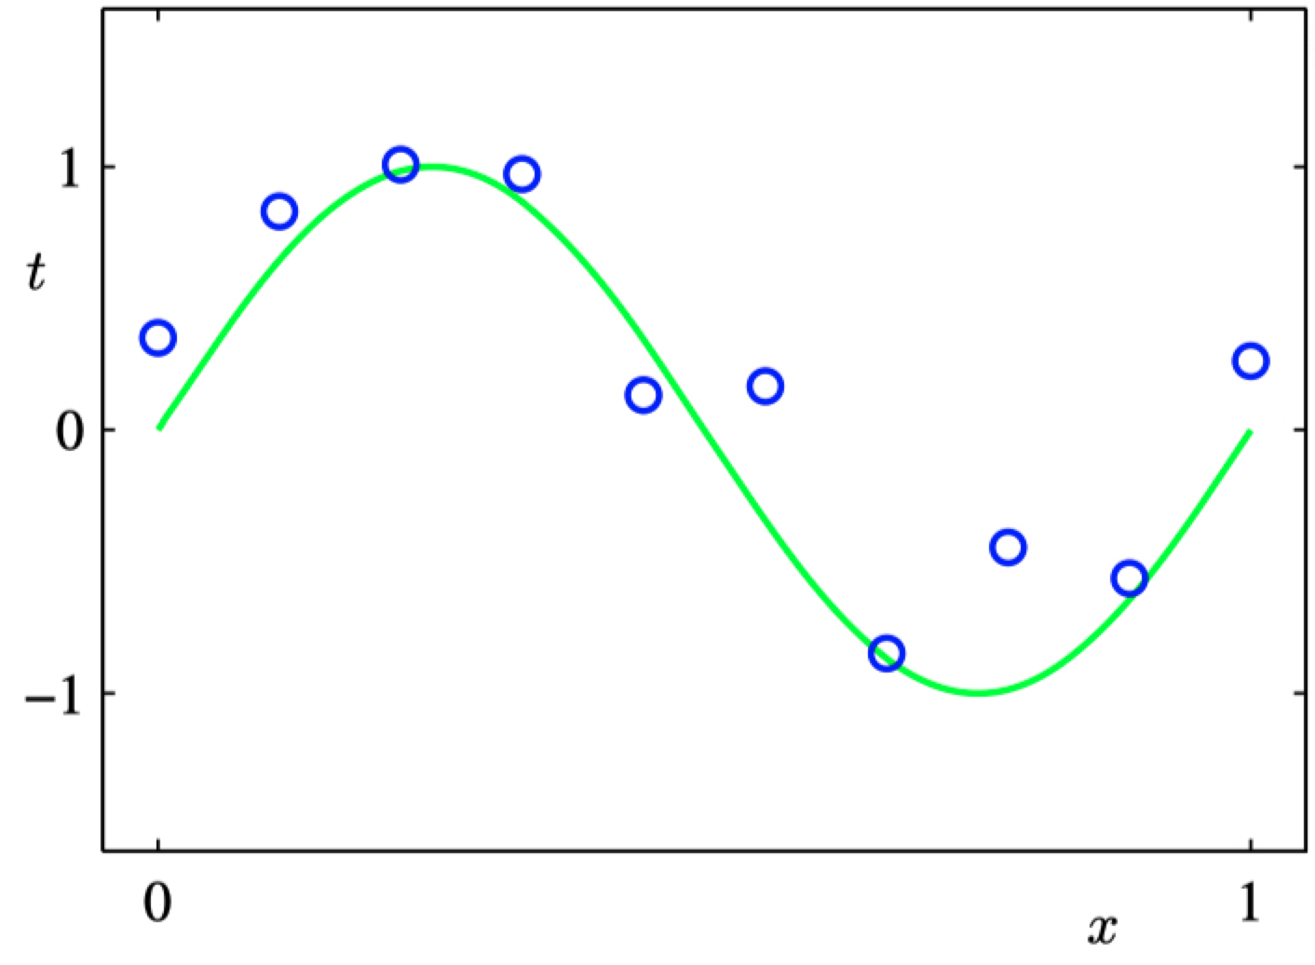
Regression
Data points (x,t) generated by adding noise to $sin⁡(2πx)$

Slide 3
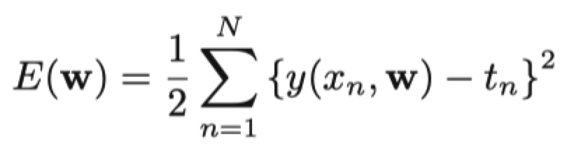
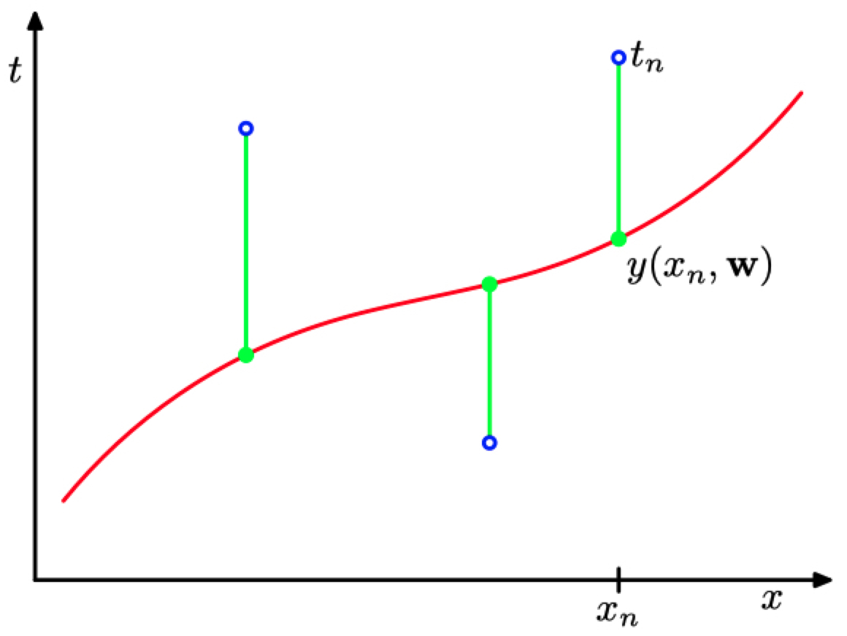
Errors in Regression
Loss Function!

Slide 4
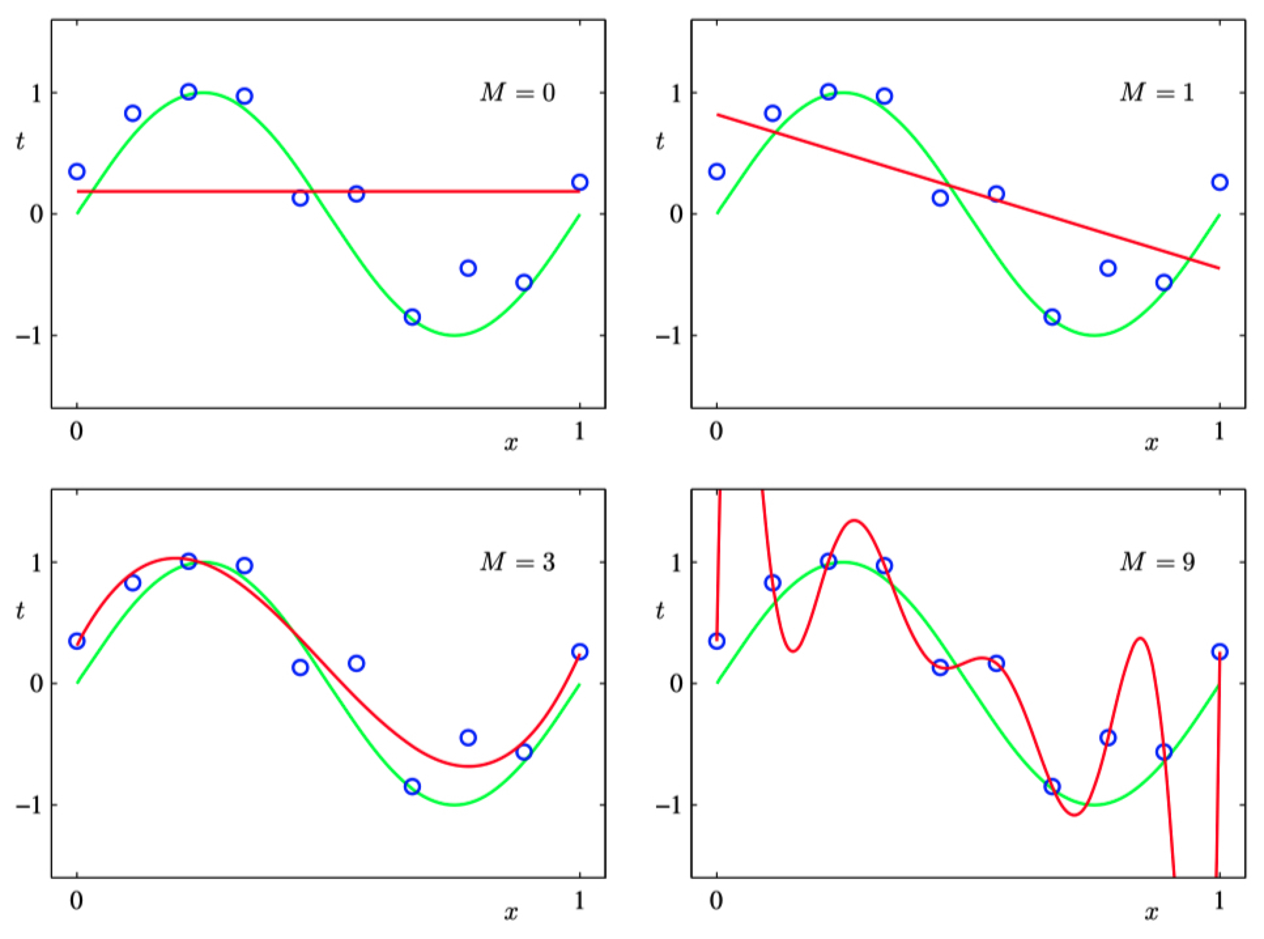

Slide 5
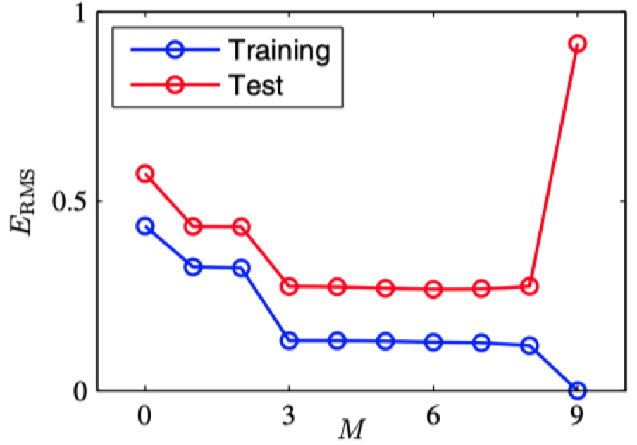
Error as a function of degree of polynomial
Error
Overfitting!
Degree of polynomial

Slide 6
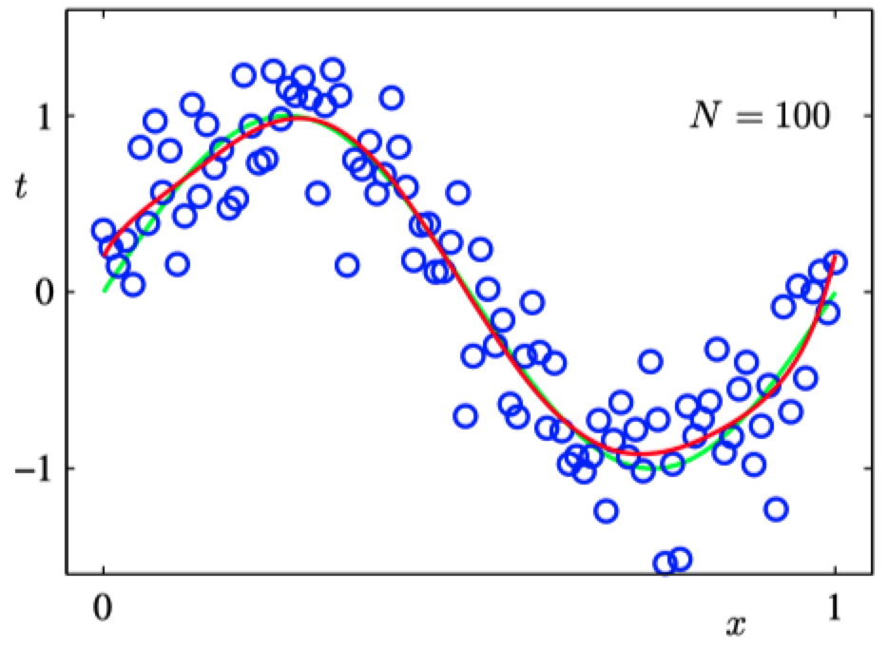
Dealing with Overfitting: (1) more data!
Degree-9 polynomial

Slide 7
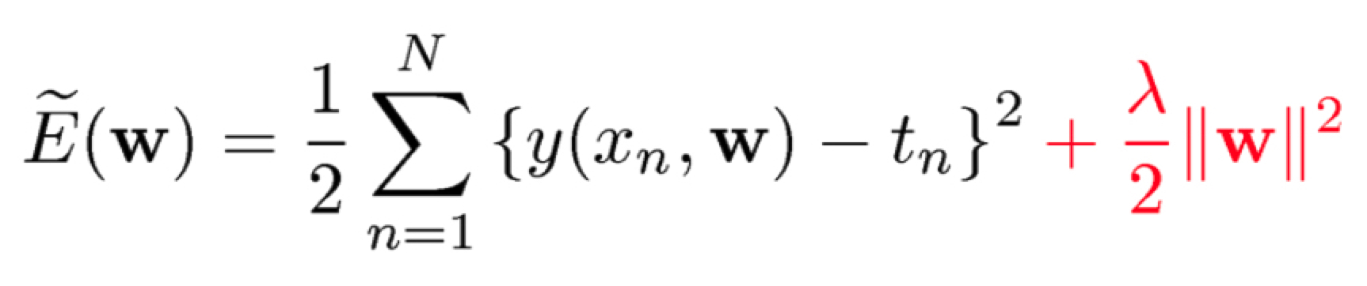


Dealing with Overfitting: (2) regularization
minimize:
Model’s squared error
Penalty on parameters

Slide 8
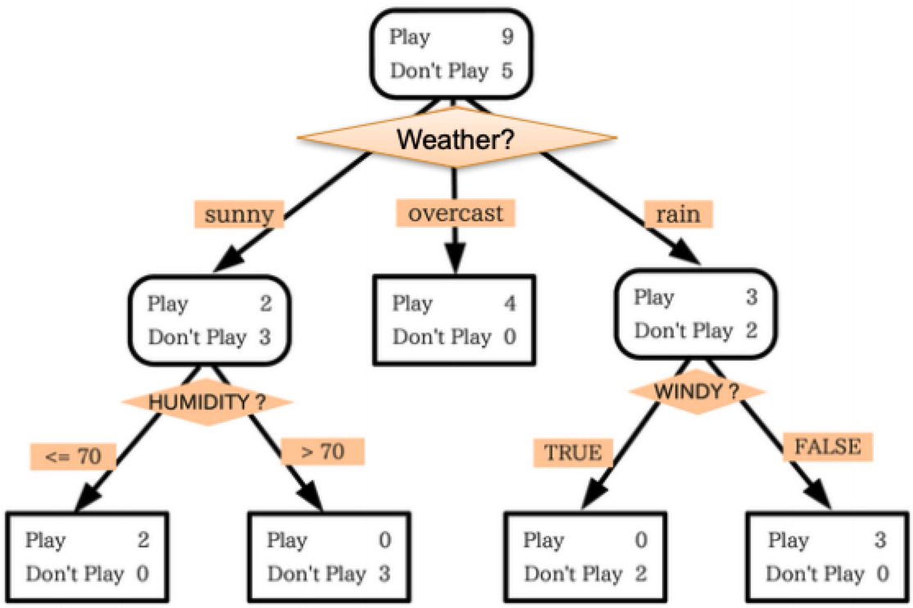
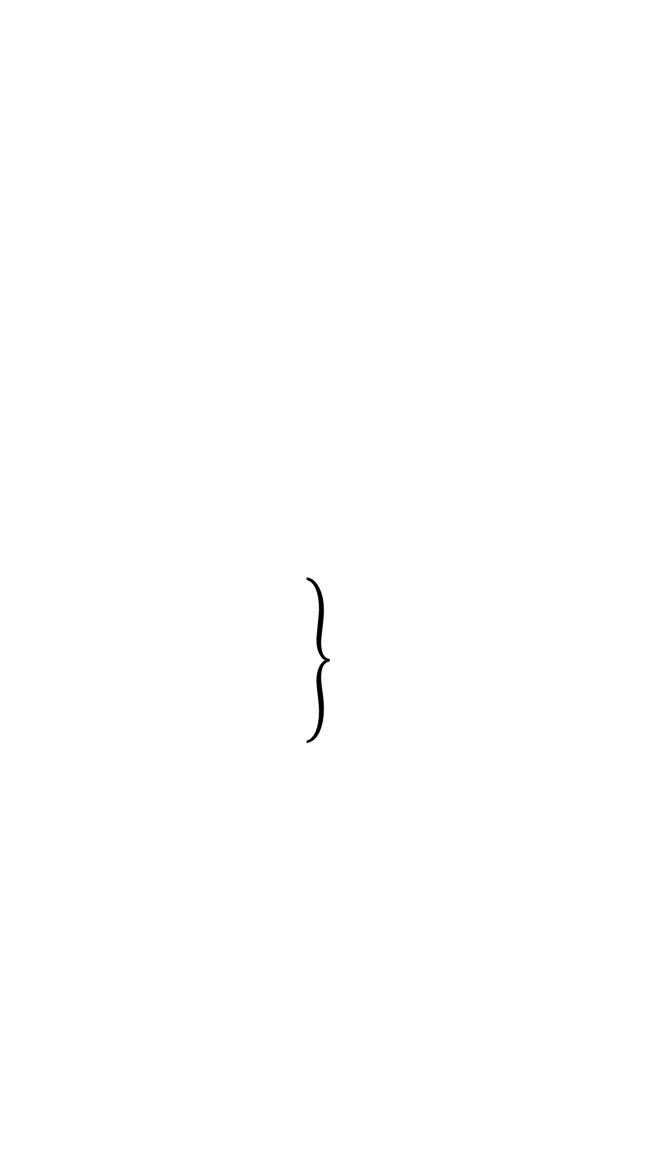
Regularization in Classification
Decision Trees
Limit the depth of the tree
Prune subtrees after training
Support Vector Machines
Built-in, tunable regularization term
Logistic Regression
Can add a tunable regularization term to MLE objective
Penalize large parameter values!

Slide 9
Underfitting: model is too simplistic!
Training loss too high → Use a more complex model

Slide 10
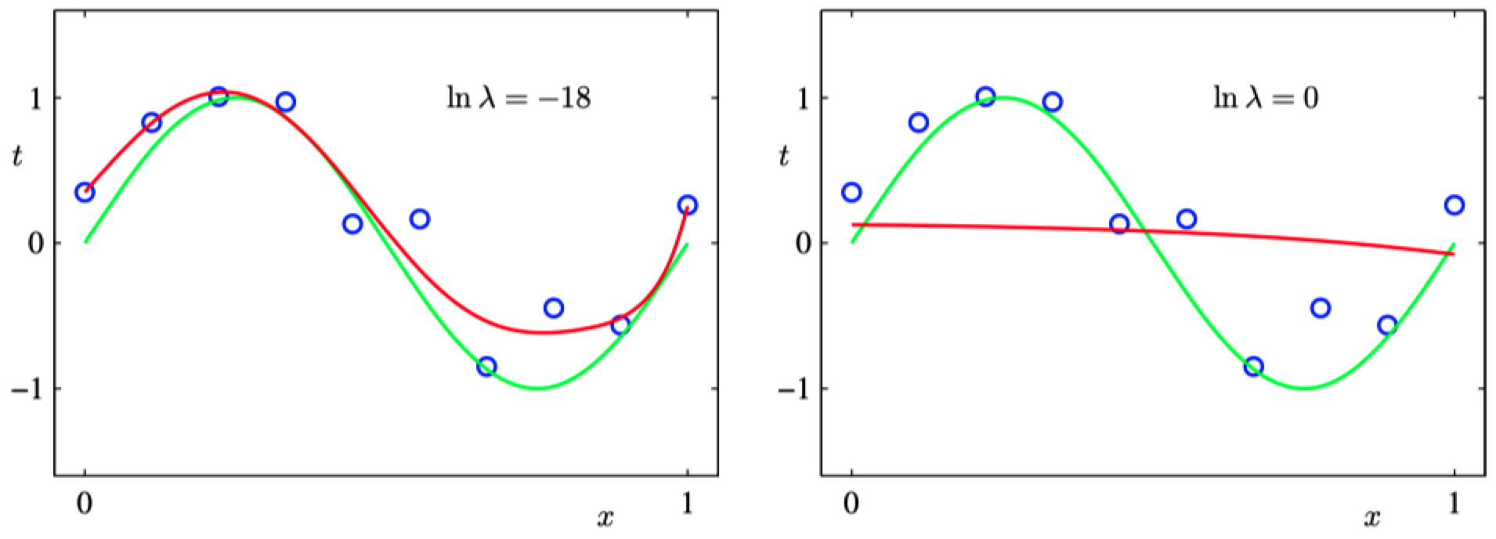


Dealing with Overfitting: (2) regularization
minimize:
$λ$ just right
$λ$ too large

Slide 11
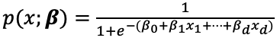
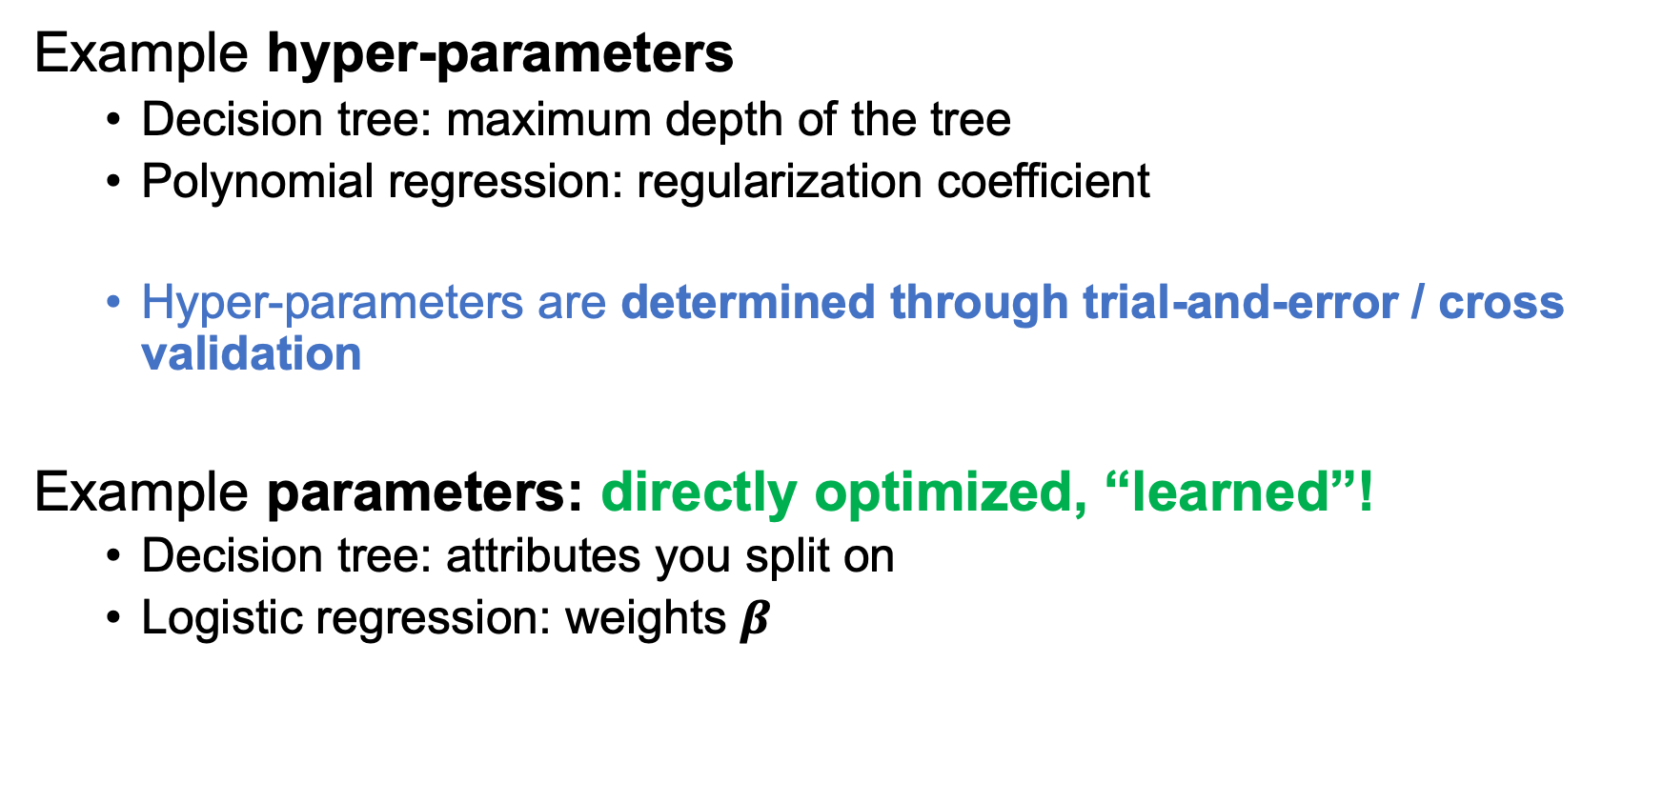
Parameters vs Hyper-parameters
Example hyper-parameters
Decision tree: maximum depth of the tree
Polynomial regression: regularization coefficient
Hyper-parameters are determined through trial-and-error / cross validation
Example parameters: directly optimized, “learned”!
Decision tree: attributes you split on
Logistic regression: weights $β$

Slide 12
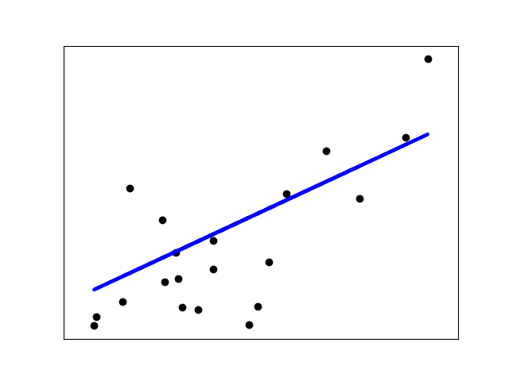
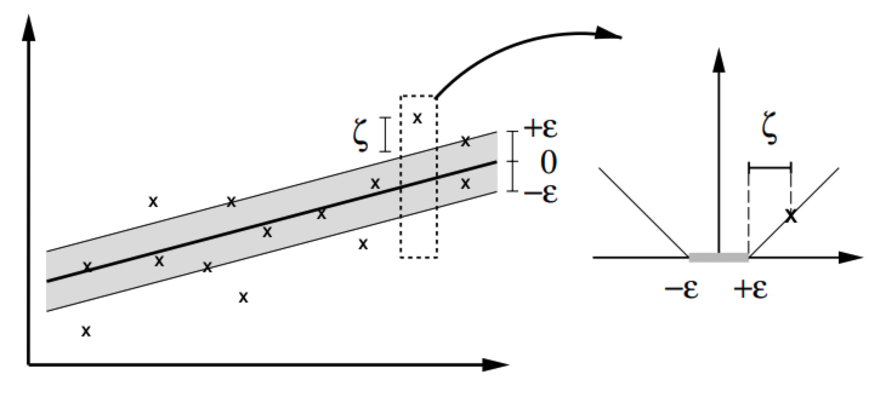
Regression
Examples:
Stock price prediction
Forecasting epidemics
Weather prediction
We will look at:
Linear Regression
Ridge Regression
LASSO
https://medium.com/@ali_88273/regression-vs-classification-87c224350d69

Slide 13
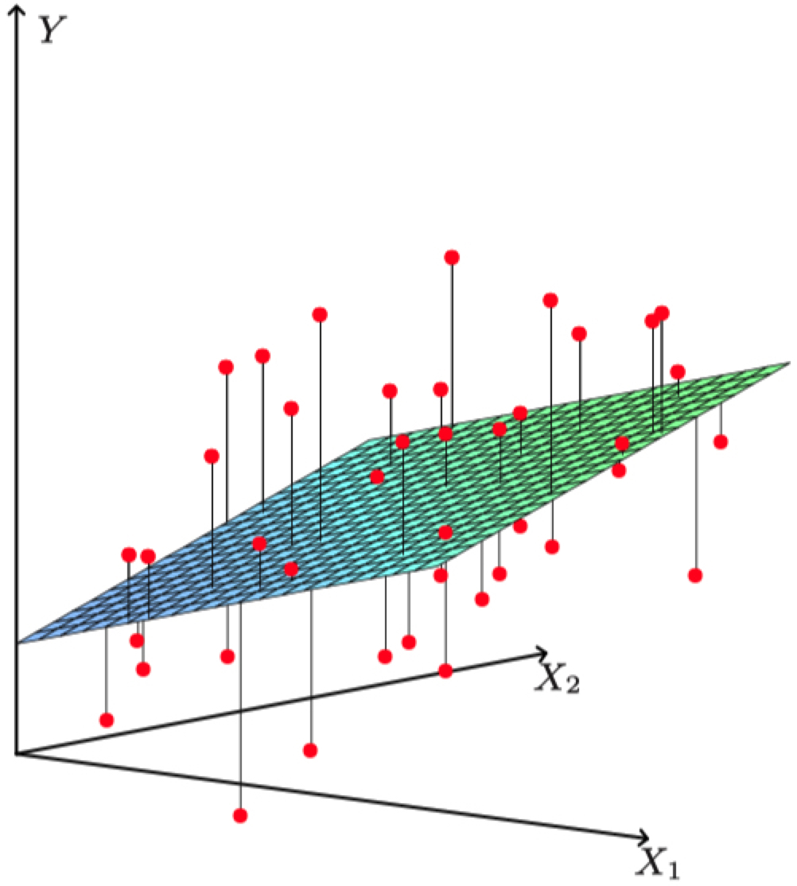
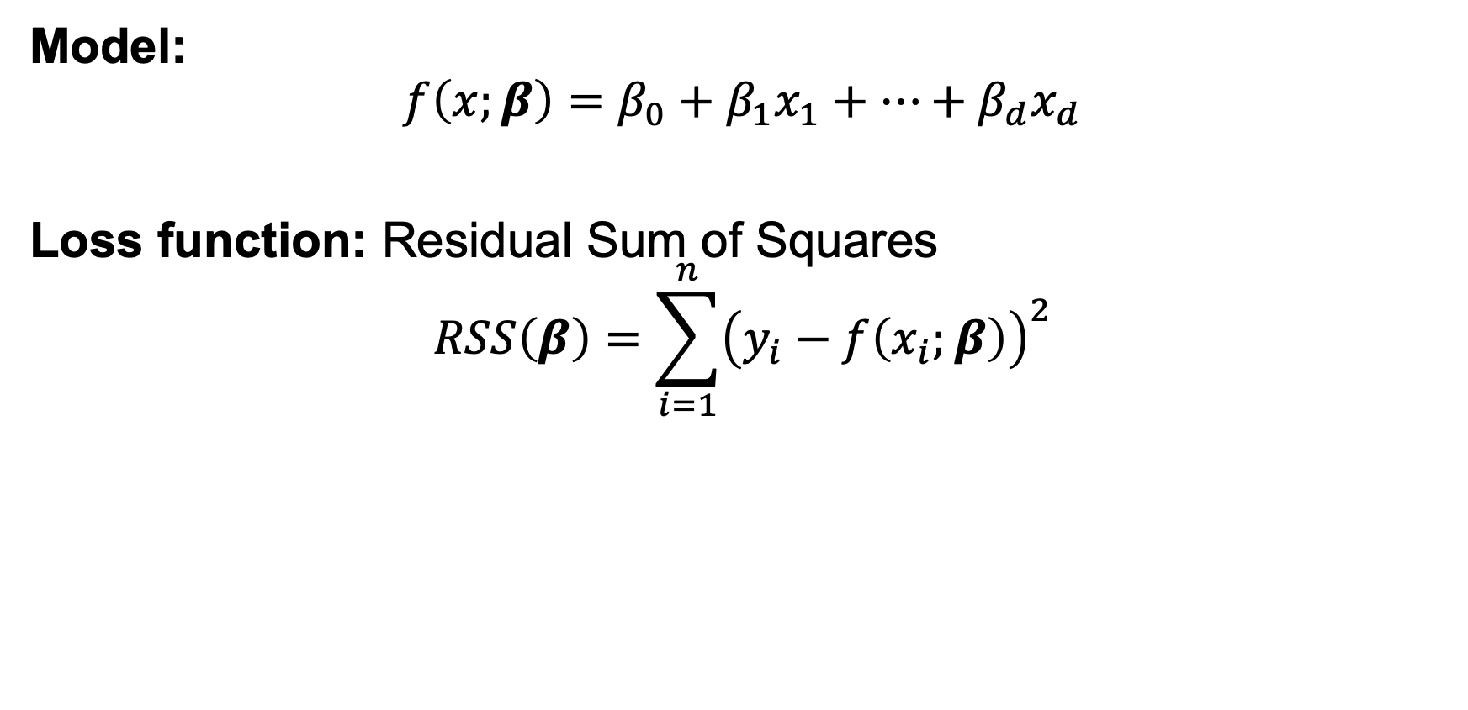
Linear Regression
Data: S = {(x_{i}, y_{i})}_{i = 1,…,n}
x_{i}: data example with d attributes
y_{i}: target of example (what you care about)
Model:
$$f\left(x;β\right)=β_{0}+β_{1}x_{1}+…+β_{d}x_{d}$$
Loss function: Residual Sum of Squares
$$RSS\left(β\right)=\sum_{i=1}^{n}{{\left(y_{i}−f\left(x_{i};β\right)\right)}^{2}}$$

Slide 14
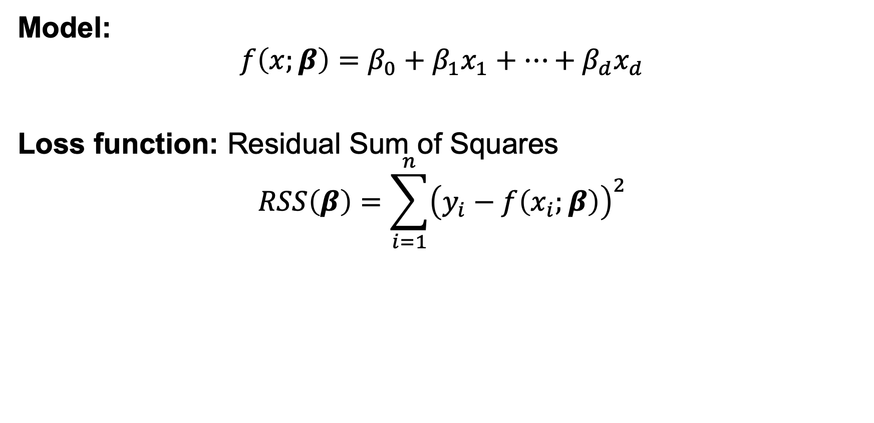
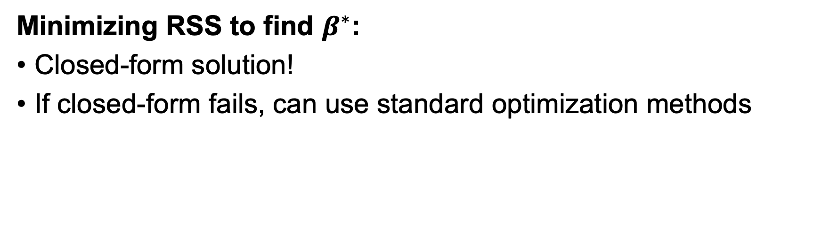
Linear Regression
Minimizing RSS to find $β^{∗}$:
Closed-form solution!
If closed-form fails, can use standard optimization methods
Model:
$$f\left(x;β\right)=β_{0}+β_{1}x_{1}+…+β_{d}x_{d}$$
Loss function: Residual Sum of Squares
$$RSS\left(β\right)=\sum_{i=1}^{n}{{\left(y_{i}−f\left(x_{i};β\right)\right)}^{2}}$$

Slide 15
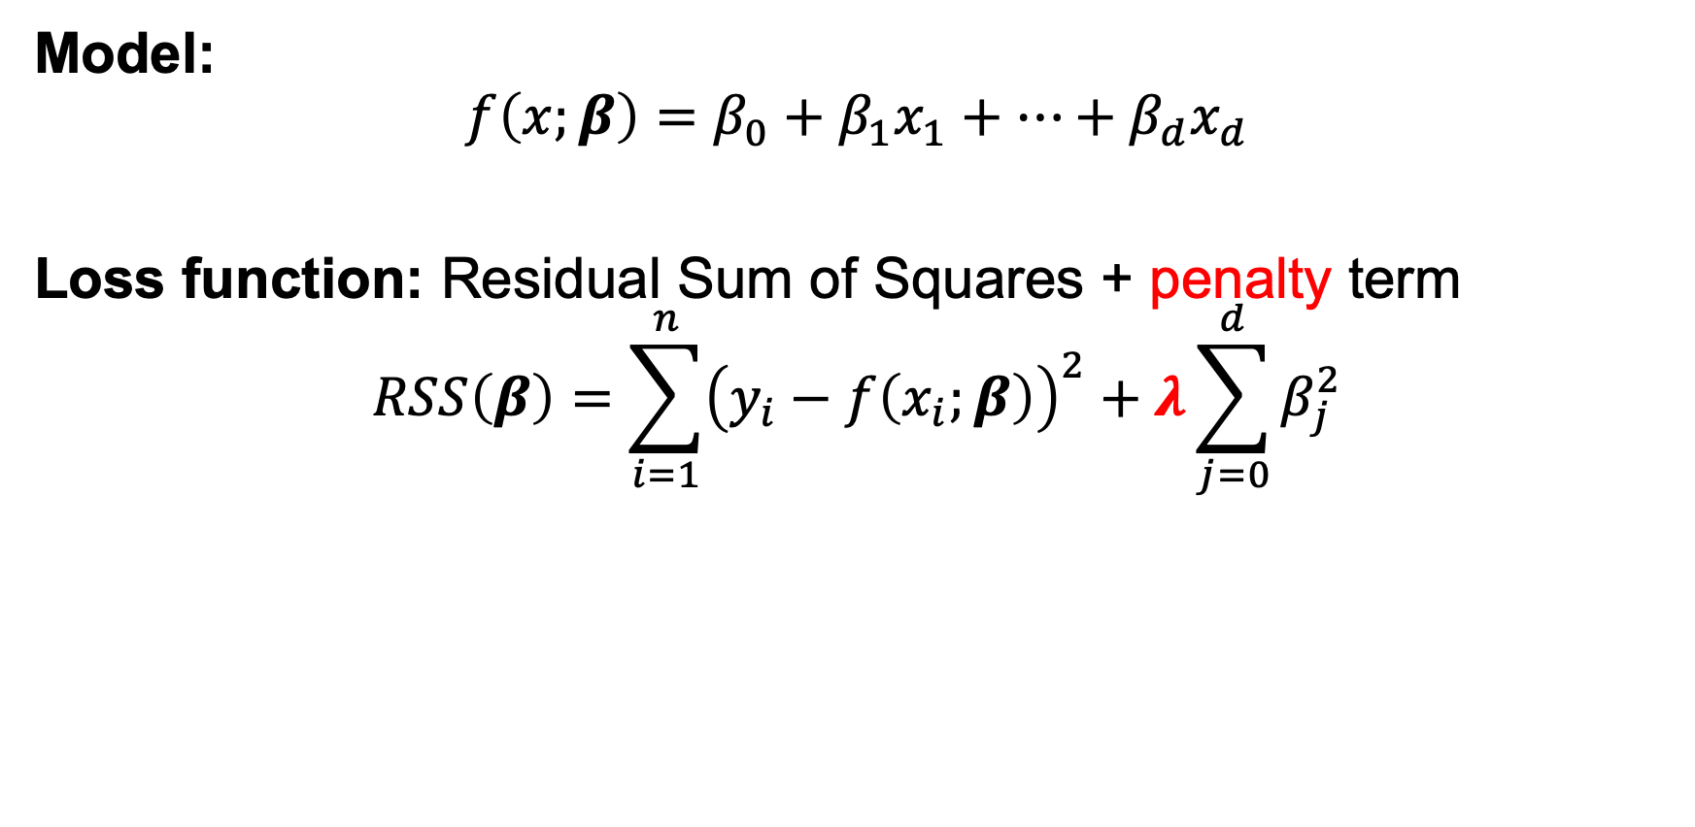
Ridge Regression
Linear Regression uses all features; model may be complicated
Ridge Regression penalizes large parameter values
Model:
$$f\left(x;β\right)=β_{0}+β_{1}x_{1}+…+β_{d}x_{d}$$
Loss function: Residual Sum of Squares + penalty term
$$RSS\left(β\right)=\sum_{i=1}^{n}{{\left(y_{i}−f\left(x_{i};β\right)\right)}^{2}}+λ\sum_{j=0}^{d}{β_{j}^{2}}$$

Slide 16
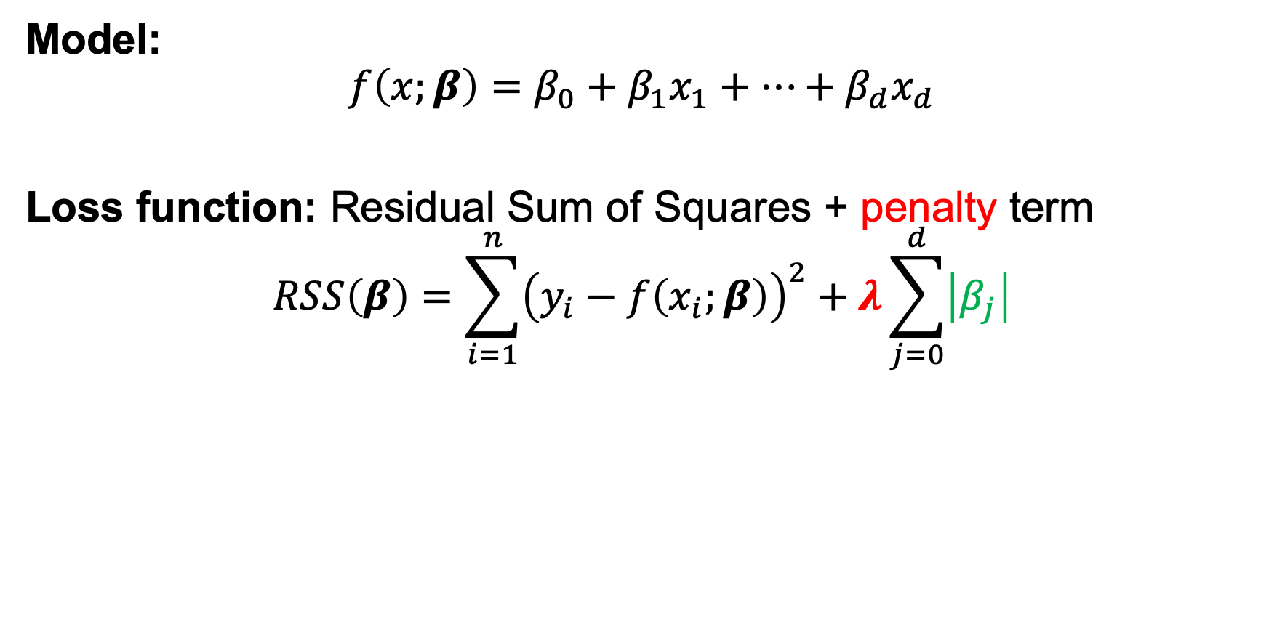
Lasso Regression
As in Ridge Regression, Lasso penalizes large parameters
Penalizes absolute instead of squared coefficient values
Zeroes out more coefficients BUT optimization is more involved
Model:
$$f\left(x;β\right)=β_{0}+β_{1}x_{1}+…+β_{d}x_{d}$$
Loss function: Residual Sum of Squares + penalty term
$$RSS\left(β\right)=\sum_{i=1}^{n}{{\left(y_{i}−f\left(x_{i};β\right)\right)}^{2}}+λ\sum_{j=0}^{d}{\left|β_{j}\right|}$$

Slide 17
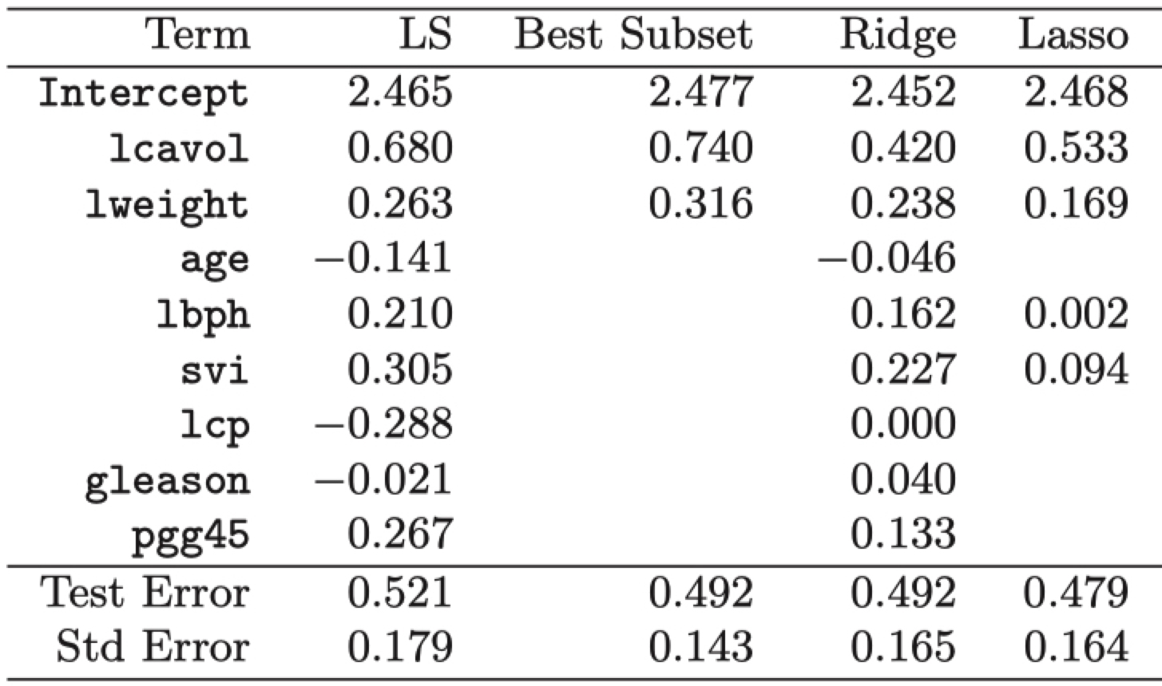
Example: Prostate Cancer
Stamey et al. (1989)
x: cancer volume, prostate weight, age, …
y: amount of prostate-specific antigen
LR

Slide 18
Bias / Variance tradeoff
Based on Joseph Redmon’s slides, UW Computer Vision class
Bias
Error from assumptions model makes about data
Linear model assumes data is linear, bad for data that isn’t
f(x)
x

Slide 19
Bias / Variance tradeoff
Based on Joseph Redmon’s slides, UW Computer Vision class
Bias
Error from assumptions model makes about data
Linear model assumes data is linear, bad for data that isn’t
Quadratic is better
f(x)
x

Slide 20
Bias / Variance tradeoff
Based on Joseph Redmon’s slides, UW Computer Vision class
Variance
Algorithm’s sensitivity to noise
More complex algorithms are more sensitive!
f(x)
x

Slide 21
Bias / Variance tradeoff
Based on Joseph Redmon’s slides, UW Computer Vision class
Variance
Algorithm’s sensitivity to noise
More complex algorithms are more sensitive!
f(x)
f(x)
x
x

Slide 22
Bias / Variance tradeoff
Based on Joseph Redmon’s slides, UW Computer Vision class
Variance
Algorithm’s sensitivity to noise
More complex algorithms are more sensitive!
High variance hurts generalization, overfitting
f(x)
f(x)
x
x

Slide 23
Bias / Variance tradeoff
Based on Joseph Redmon’s slides, UW Computer Vision class
Noise
Random variations in data
Bias
Error from assumptions model makes about data
Less complex algorithms -> more assumptions about data
Variance
Algorithm’s sensitivity to noise
More complex algorithms are more sensitive!
High variance hurts generalization
Error = Noise + Bias + Variance

Slide 24
Linear regression
Based on Joseph Redmon’s slides, UW Computer Vision class
f*(x) = ax + b
High bias: linear assumption
Low variance
Benefits:
Closed form solution
Fast to compute for new data
Weaknesses:
Not very powerful, assumes linear
Underfit more interesting data
f(x)
x

Slide 25
Nearest neighbor regression
Based on Joseph Redmon’s slides, UW Computer Vision class
f*(x) = f(x’) for nearest x’ in training set
Low bias: no assumptions about data
High variance: very sensitive to training set
Benefits:
Super easy to implement
Easy to understand
Arbitrarily powerful, esp with lots of data
Weaknesses:
Hard to scale
Prone to overfitting to noise
f(x)
x

Slide 26
ML as an Optimization problem: Regression
minimize:
Model’s squared error
Penalty on parameters

Slide 27
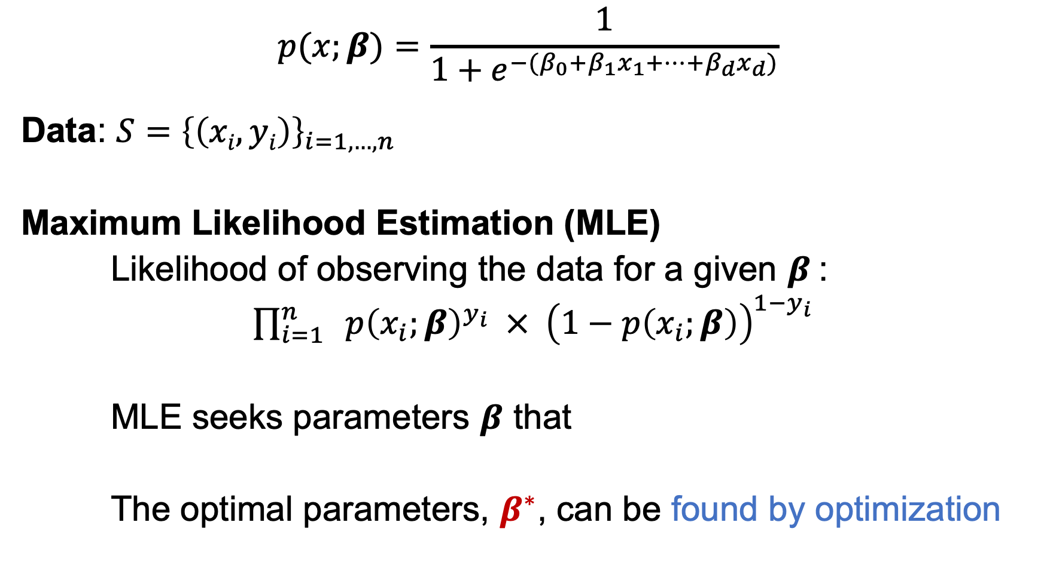
ML as an Optimization problem: Logistic Regression
$$p(x;β)=\frac{1}{1+e^{−(β_{0}+β_{1}x_{1}+…+β_{d}x_{d})}}$$
Data: $S={\left\{\left(xi, yi\right)\right\}}_{i=1,…, n}$
Maximum Likelihood Estimation (MLE)
Likelihood of observing the data for a given $β$:
$\prod_{i=1}^{n}{ p{\left(x_{i};β\right)}^{y_{i}} × {\left(1−p\left(x_{i};β\right)\right)}^{1−y_{i}}}$
MLE seeks parameters $β$ that maximize the likelihood
The optimal parameters, $β^{∗}$, can be found by optimization
x_{i}: example with d attributes (age, #pregnancies, …)
y_{i}: cervical cancer diagnosis (0 or 1)
Notes:
https://christophm.github.io/interpretable-ml-book/logistic.html

Slide 28

Convexity
For convex problems, gradient descent gets us to global minima. It’s that easy!
Graphically… which of these is convex?
Loss
w
w
w
w

Slide 29
Non-convexity
Usually no easy way to find global or local optima, harder to optimize
Loss

Slide 30
Gradient descent
Based on Joseph Redmon’s slides, UW Computer Vision class
For some loss function L(w), gradient ∇L(w) points towards in direction of steepest ascent.
In 1d, either points left or right

Slide 31
Gradient descent
Based on Joseph Redmon’s slides, UW Computer Vision class
For some loss function L(w), gradient ∇L(w) points towards in direction of steepest ascent.
In 1d, either points left or right

Slide 32
Gradient descent
Based on Joseph Redmon’s slides, UW Computer Vision class
For some loss function L(w), gradient ∇L(w) points towards in direction of steepest ascent.
In 1d, either points left or right

Slide 33
Gradient descent
Based on Joseph Redmon’s slides, UW Computer Vision class
For some loss function L(w), gradient ∇L(w) points towards in direction of steepest ascent.
In 1d, either points left or right

Slide 34
Gradient descent
Based on Joseph Redmon’s slides, UW Computer Vision class
For some loss function L(w), gradient ∇L(w) points towards in direction of steepest ascent.
In 1d, either points left or right
Algorithm:
Take derivative Move slightly in other direction Repeat

Slide 35
Gradient descent
Based on Joseph Redmon’s slides, UW Computer Vision class
For some loss function L(w), gradient ∇L(w) points towards in direction of steepest ascent.
In 1d, either points left or right
Algorithm:
Take derivative Move slightly in other direction Repeat

Slide 36
Gradient descent
Based on Joseph Redmon’s slides, UW Computer Vision class
Algorithm:
Take derivative Move slightly in other direction Repeat
End up at local optima

Slide 37
Gradient descent
Based on Joseph Redmon’s slides, UW Computer Vision class
Formally: w_{t+1}= w_{t} - η ∇L(w)
Where η is step size, how far to step relative to the gradient

Slide 38
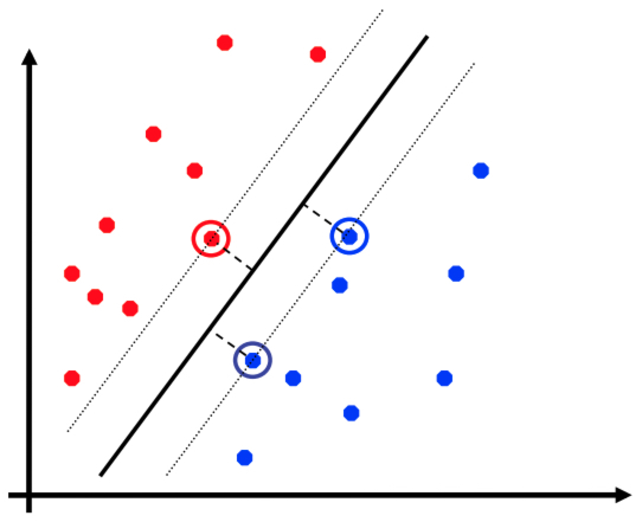
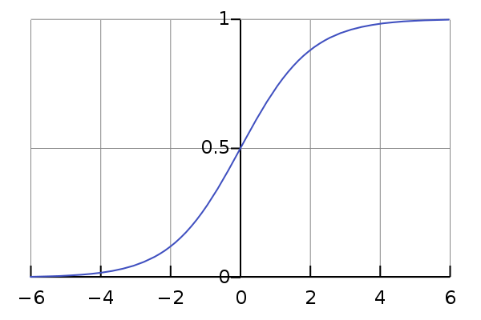
Optimization in Classification
Decision Trees
Very hard to find optimal tree (min. misclassification)
Top-down heuristic as shown in Lecture 1
Support Vector Machines
Convex optimization!
Logistic Regression
Convex optimization!

Slide 39
Recap
Regression models:
Linear Regression
Ridge Regression
Lasso
Overfitting and Underfitting
Bias-Variance Tradeoff
Gradient Descent for ML
Error = Noise + Bias + Variance
w_{t+1}= w_{t} - η ∇L(w)

